Slide 1
AR Pets
Second Update

Slide 2
What we’ve done
Unity Tutorials
Interface Design
Blender Work
Planning

Slide 4
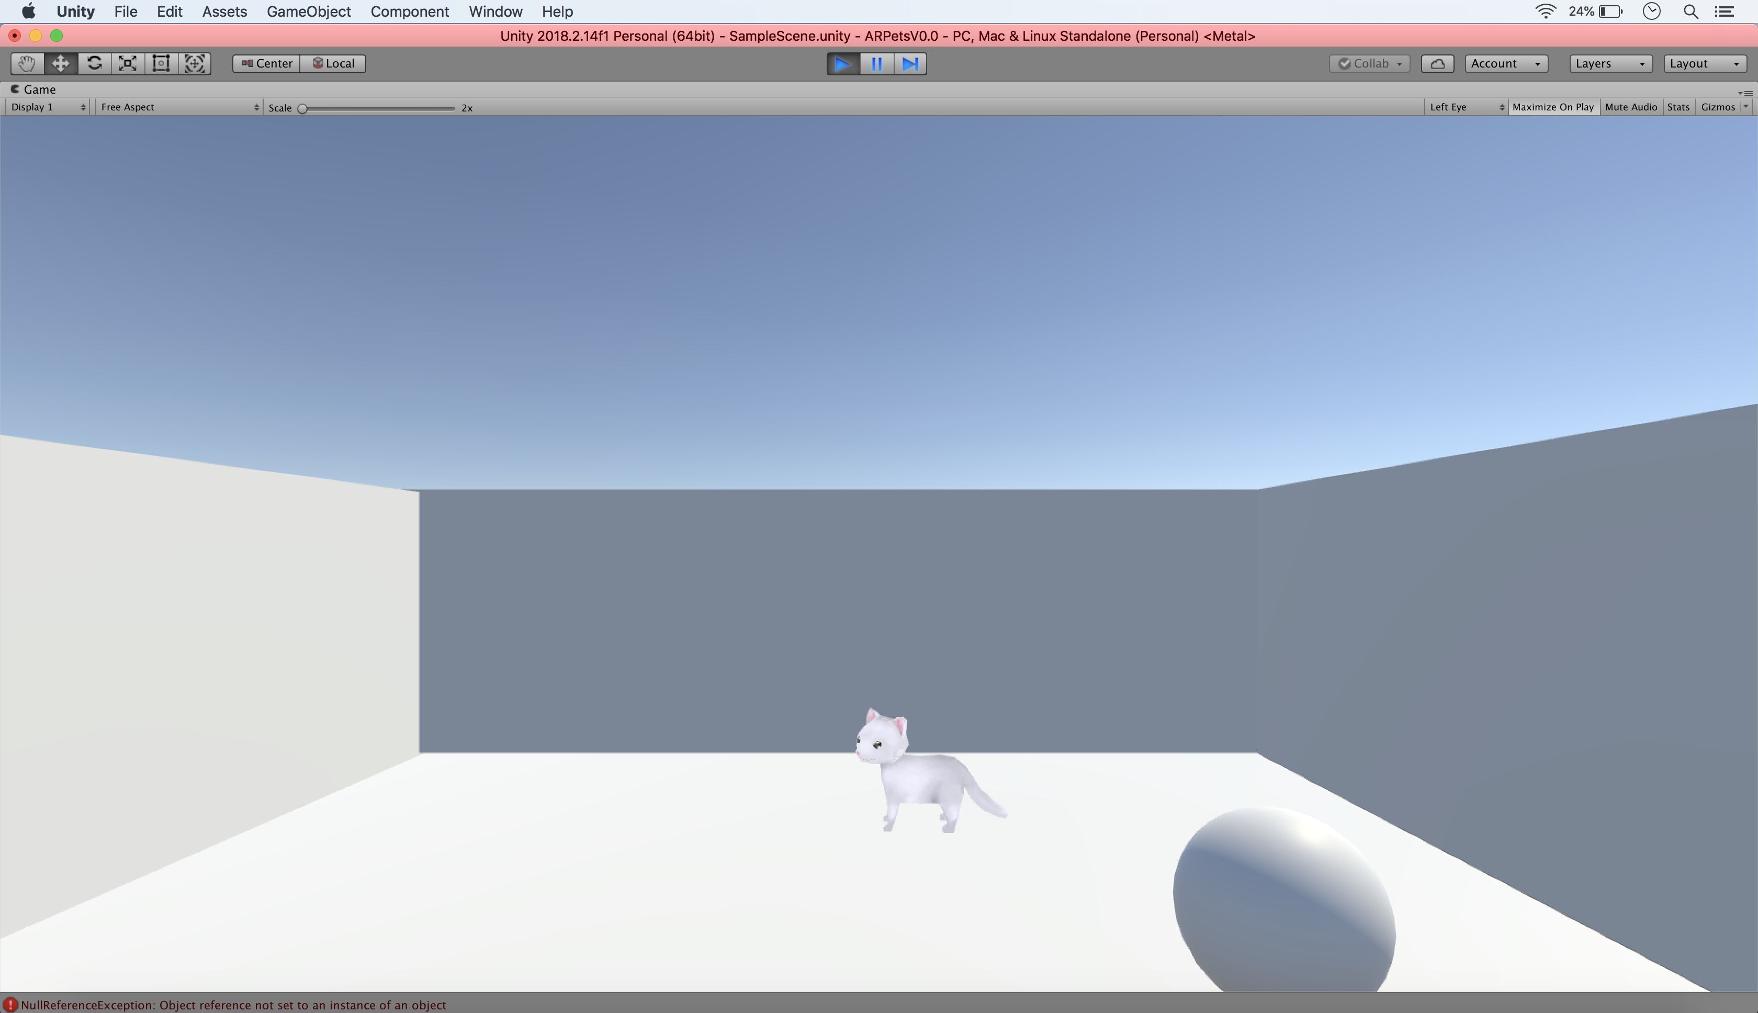

Slide 5
Roadmap for the end of break
Headset Interactivity
Furnished Environment
Develop During Winter Break
Models and Animations Done

Slide 6
Techshift
Now focusing on both AR and VR
Currently have access to the following platforms
Oculus
Vive
Hololens

Slide 7
Funding
No funding - University Resources
Magic Leap Grant

